Slide 1















Multilingual Sentiment Analysis
Shubham Ojha
20BCE1205
VIT Chennai
Capstone Project
REVIEW - 2
Guide - Dr. Rajalakshmi R

Slide 2

INTRODUCTION
Multilingual Sentiment Analysis, specifically in this study, is a computational technique for identifying and categorizing emotions expressed in text across multiple languages, with a focus on the Malayalam language.
This project utilizes machine learning algorithms to analyze and distinguish between authentic and counterfeit sentiments in social media posts and comments.
This project stands as a testament to the potential of machine learning in breaking language barriers and enriching our understanding of global digital communications.

Slide 3
Problem Statement
Address the scarcity of sentiment classification models for non-English languages.
Develop a multilingual sentiment analysis framework for the Malayalam language.
Focus on fake news detection and verification of originality in YouTube comments.

Slide 4
Research Objective
Determine the authenticity of YouTube comments through advanced machine learning (ML) algorithms.
Classify news articles in Malayalam into five categories: True, Mostly True, Half True, False, and Mostly False.
Identify and evaluate the most effective ML algorithm for both YouTube comment authenticity and news classification in Malayalam.
Measure and validate the accuracy of the selected ML algorithm using testing data to ensure reliable results.

Slide 5
Proposed System Introduction:
Proposed System Implements models for identifying the originality of Malayalam language YouTube comments and detecting fake news using supervised learning algorithms.
Utilizing deep learning techniques specifically for fake news detection, divided into three distinct parts:
Initially applying the BERT model directly to the Malayalam text for classification.
Translating the Malayalam text to English and then applying the BERT model to the translated text for enhanced understanding and classification.
Employing Indic BERT tokenizer and model specifically designed for Indian languages, including Malayalam, to classify the content more accurately.

Slide 6
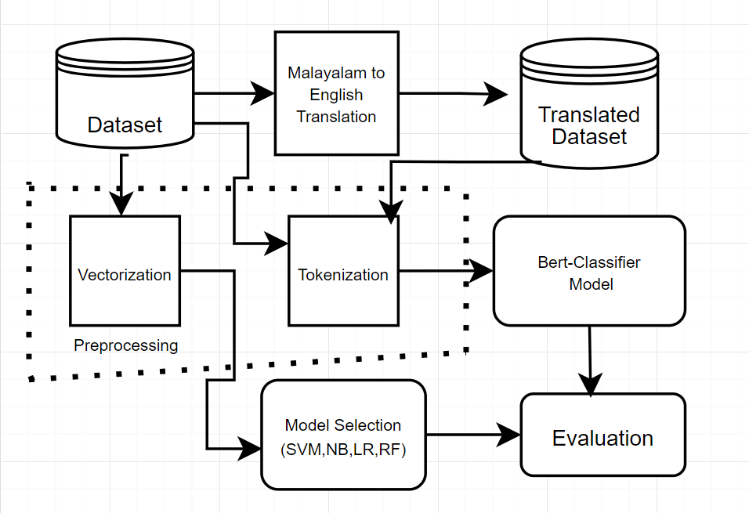
Proposed System Diagram:

Slide 7
List of modules:
Data Preprocessing
Model Selection
Machine Translation
Evaluation

Slide 8
Data Preprocessing
Vectorization for Supervised Learning:
Transform text to numerical data using TF-IDF/Count Vectorizer.
Enables language processing by machine learning models.
BERT Tokenizer:
Tokenize with BertTokenizer.from_pretrained('bert-base-uncased').
Converts words to token IDs, and handles special tokens.
Creating Tensor for BERT:
Convert token IDs to tensors for BERT model input.
Apply padding, and attention masks for variable sentence lengths.

Slide 9
Model Selection
Implemented Models: Applied four supervised learning algorithms: SVM, Logistic Regression, Naive Bayes, and Random Forest, catering to diverse decision boundaries and hypothesis spaces.
Parameter Optimization: Utilized Grid Search for each model to systematically explore a wide range of parameters and identify the optimal settings for fine-tuning model performance.
Validation and Comparison: Evaluated models based on validation scores, leveraging cross-validation techniques to ensure robustness and minimize overfitting.
Best Model Selection: The model with the highest validation score was selected as the best model, demonstrating superior predictive capability on unseen data.

Slide 10
Machine translation
Initialize Translation Pipeline: Set up with transformers' pipeline for Malayalam to English using the "Helsinki-NLP/opus-mt-ml-en" model.
Batch Processing Function: translate_texts translate lists of texts, skipping empty entries, and uses “tqdm” for progress tracking.
Translate and Append: For each text, perform translation to English and append to a list, handling empty strings appropriately.
Update DataFrame: Apply translation function to df['News'], saving results in df['translated_text'].

Slide 11
Evaluation
Accuracy Measurement: Evaluate the final model's accuracy on test data to quantify its performance in correctly predicting outcomes.
Validation Score Monitoring: Use validation scores during model training to fine-tune parameters and select the best-performing model.
Epochs: Epochs determine the number of times the learning algorithm will work through the entire training dataset, crucial for learning patterns and achieving optimal performance.

Slide 12
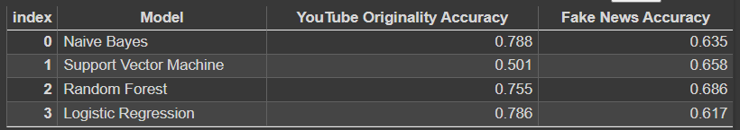
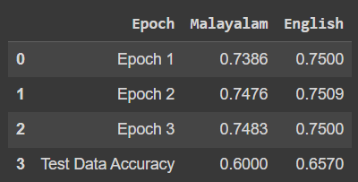
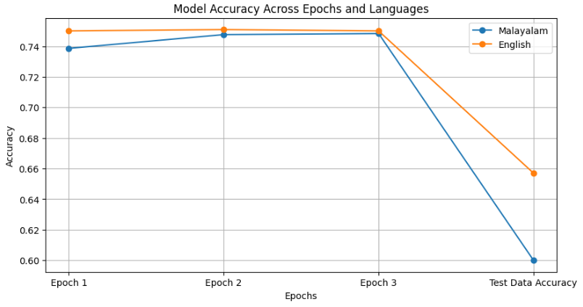
Results

Slide 13
What to be done next
Implement Indic BERT Tokenizer: To improve tokenization for Malayalam text.
Use Indic BERT AutoModel: For pre-trained Indian language capabilities.
Fine-Tune Model: Adapt Indic BERT to our dataset for better accuracy.
Iterate and Evaluate: Continuously refine and assess model performance.

Slide 14
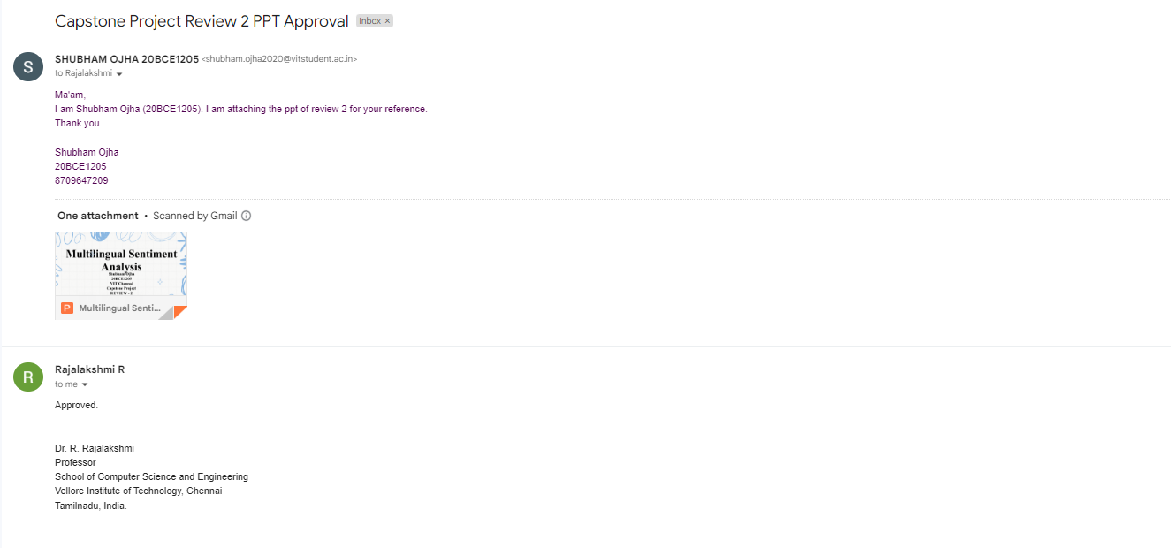
Guide Approval Mail Snapshot

Slide 15
References
Helsinki-NLP. (n.d.). opus-mt-ru-en. Hugging Face. Retrieved from https://huggingface.co/Helsinki-NLP/opus-mt-ru-en
AI4Bharat. (n.d.). indic-bert. Hugging Face. Retrieved from https://huggingface.co/ai4bharat/indic-bert
AI4Bharat. (n.d.). Indic-BERT-v1. GitHub. Retrieved from https://github.com/AI4Bharat/Indic-BERT-v1
Kakwani, D., Kunchukuttan, A., Golla, S., N.C., G., Bhattacharyya, A., Khapra, M. M., & Kumar, P. (n.d.). IndicNLPSuite: Monolingual Corpora, Evaluation Benchmarks and Pre-trained Multilingual Language Models for Indian Languages.
Yarullin, R., & Serdyukov, P. (n.d.). BERT for Sequence-to-Sequence Multi-label Text Classification.
Devlin, J., Chang, M.-W., Lee, K., & Toutanova, K. (2019). BERT: Pre-training of deep bidirectional transformers for language understanding.

Slide 16
Thank you very much!

